Slide 1
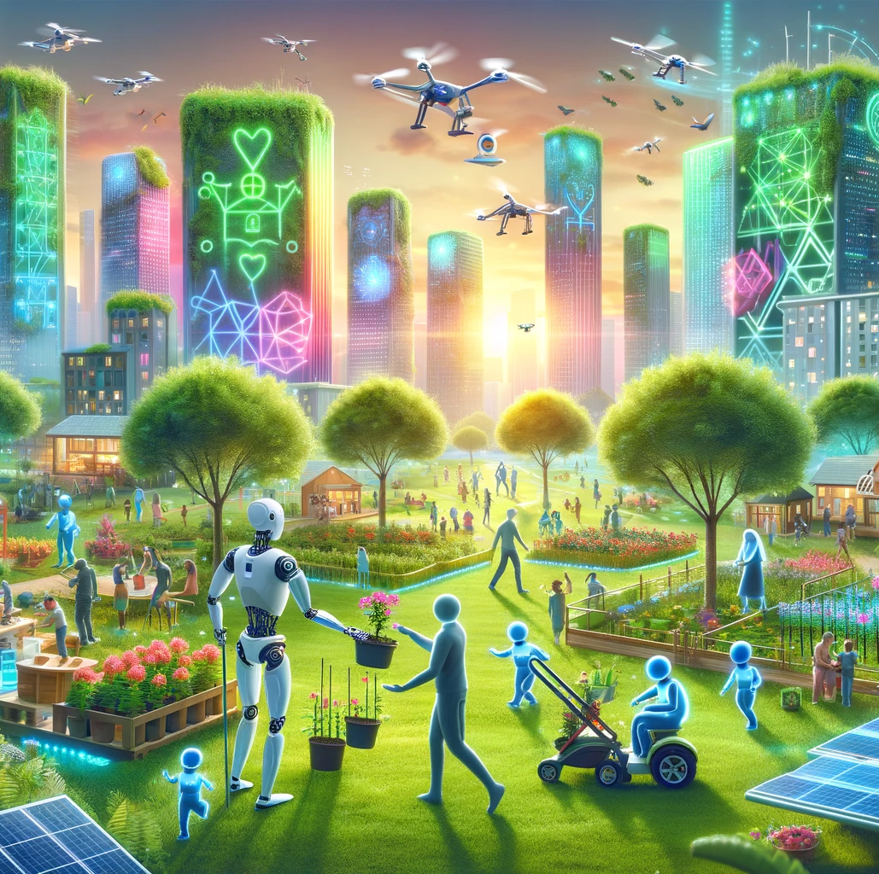
Artificial Intelligence: Benefits, risks and prime directives for the Global South
Soumya Banerjee
University of Cambridge

Slide 2
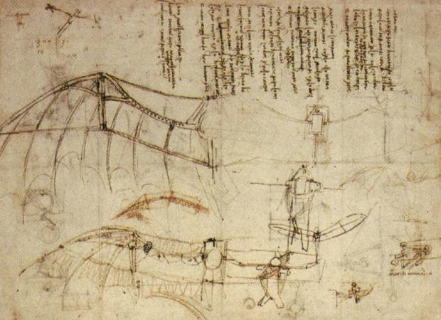
Mimicking nature

Slide 3

What is AI?
Can we mimic what is going on in our brains?

Slide 4
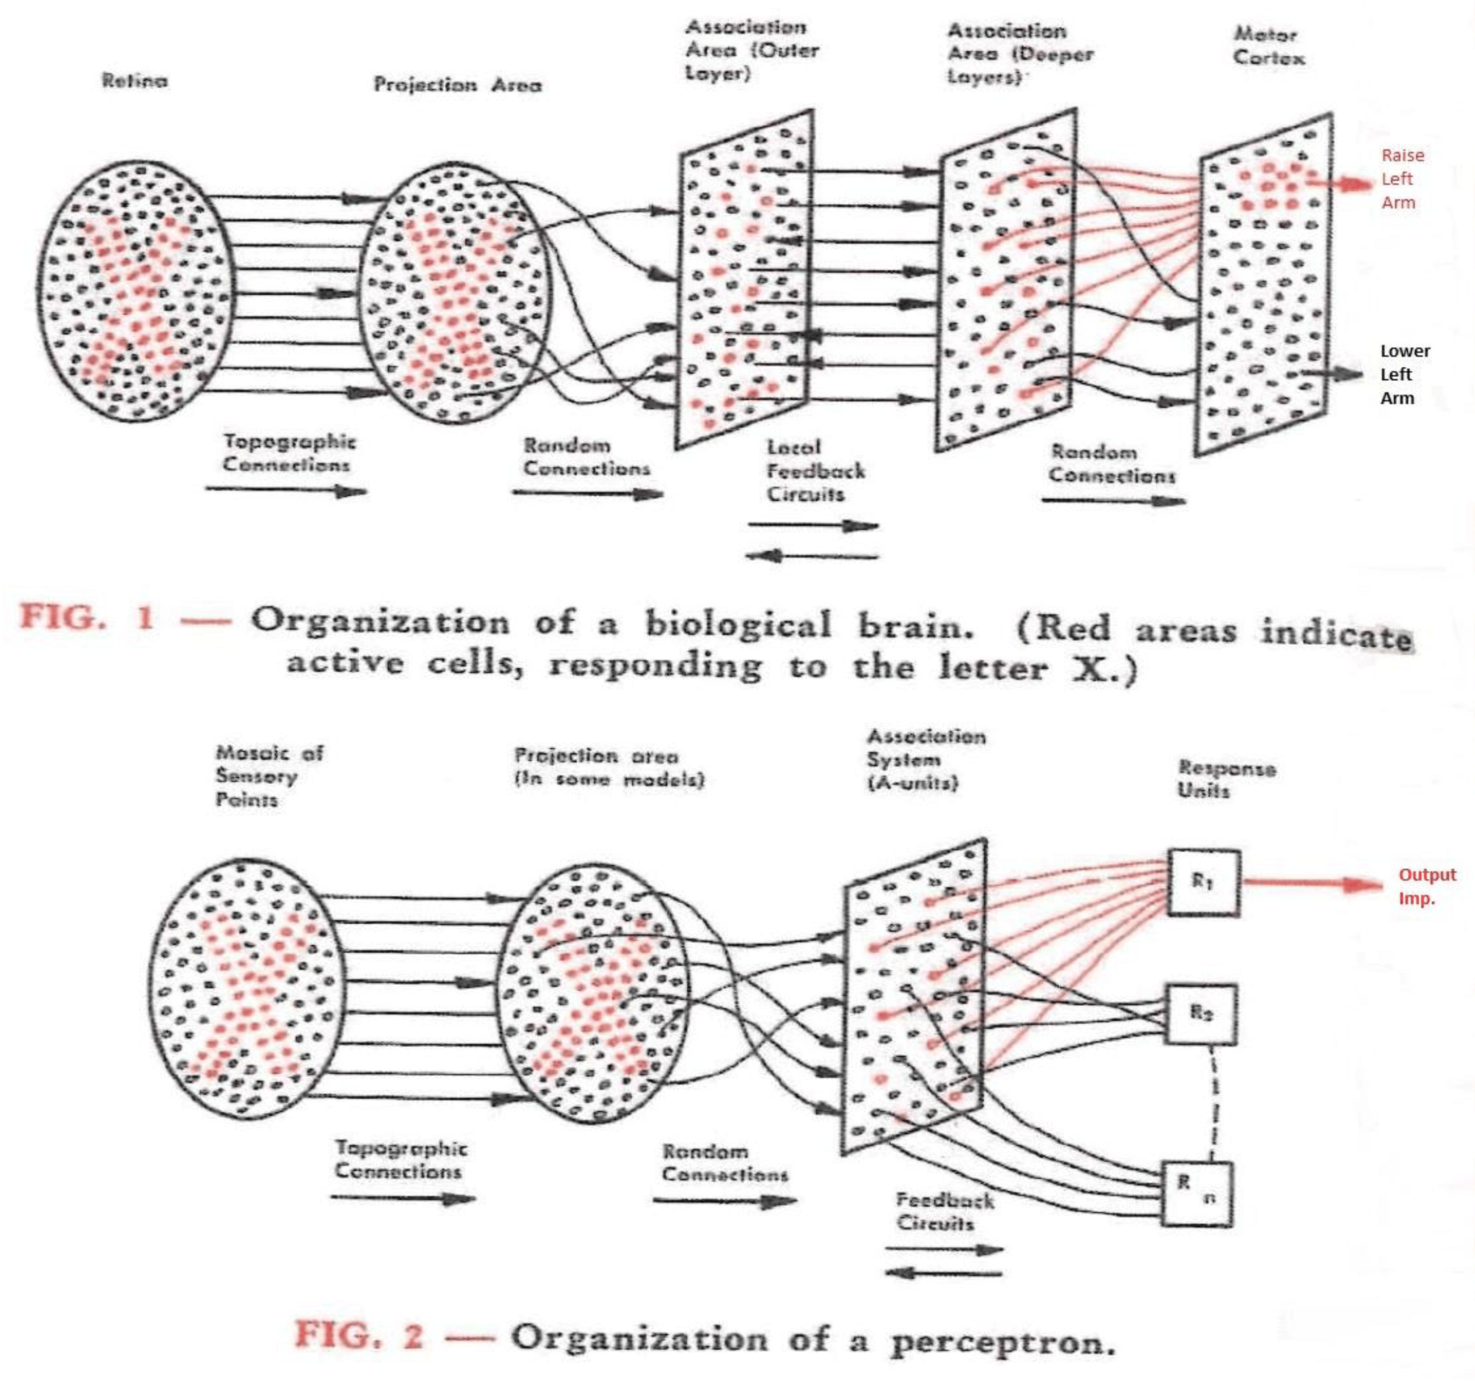
What is AI?
Baby steps
Perceptron

Slide 5
Can machines think?
Can a submarine swim?
“The question of whether a computer can think is no more interesting than the question of whether a submarine can swim” – Edsger Dijkstra
Our notions of intelligence are ill-defined and very anthropocentric
Intelligence in animals, humans and machines: a heliocentric view of intelligence? Halfdan Holm, Soumya Banerjee, AI & Society, 2024

Slide 6
Risks of AI
Ethical considerations
Bias
Data privacy
Impact on jobs
Systemic effects on our planet
Risk of anthropomorphizing

Slide 7
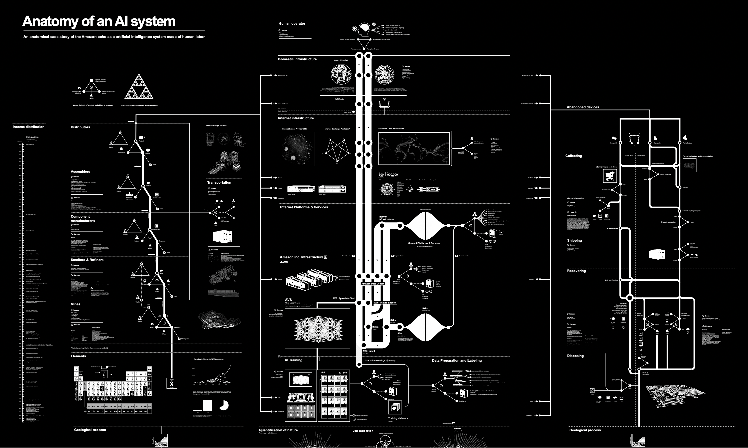

Other AI risks

Slide 8
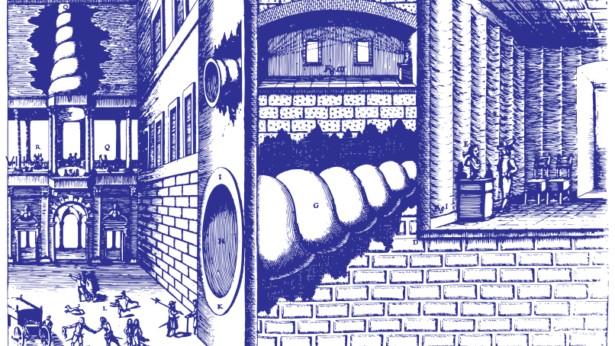
Other AI risks
Notes:
In 1673, the Jesuit polymath, Athanasius Kircher, invented the statua citofonica – the ‘talking statue.’ K

Slide 9
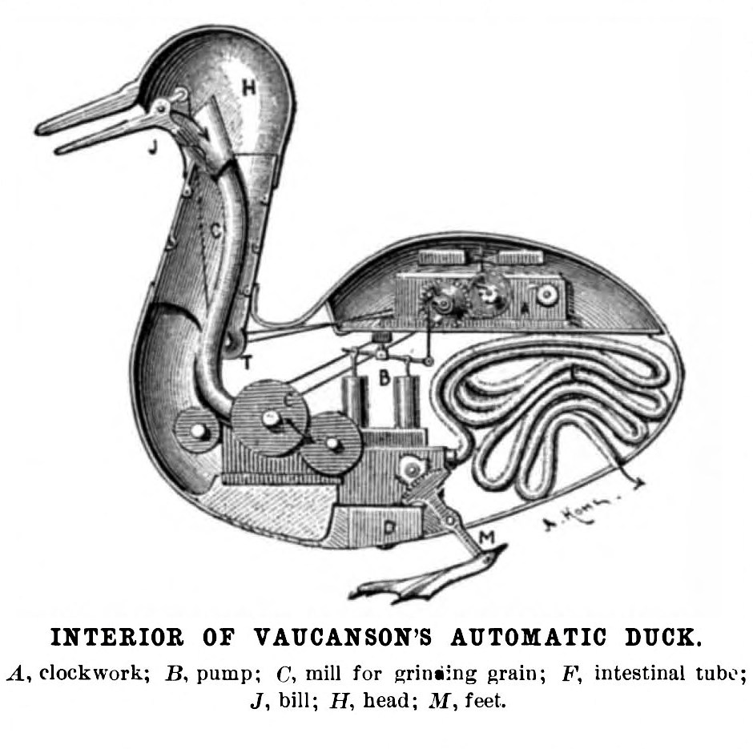
Notes:
Digesting Duck, was an automaton in the form of a duck, created by Jacques de Vaucanson and unveiled on 30 May 1764 chatGPT

Slide 10
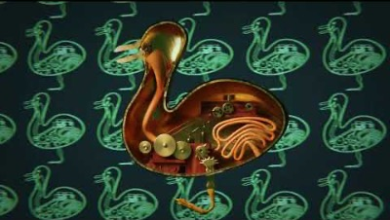
Notes:
https://www.youtube.com/watch?v=Jq_P1dNZvdY

Slide 11
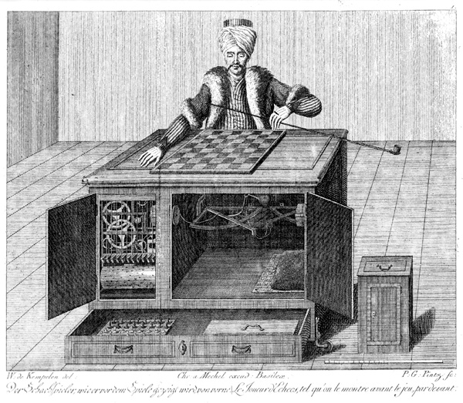
Notes:
Automaton Chess Player (German: Schachtürke, lit. 'chess Turk'; Hungarian: A Török), or simply The Turk, was a fraudulent chess-playing machine constructed in 1770, which appea

Slide 12
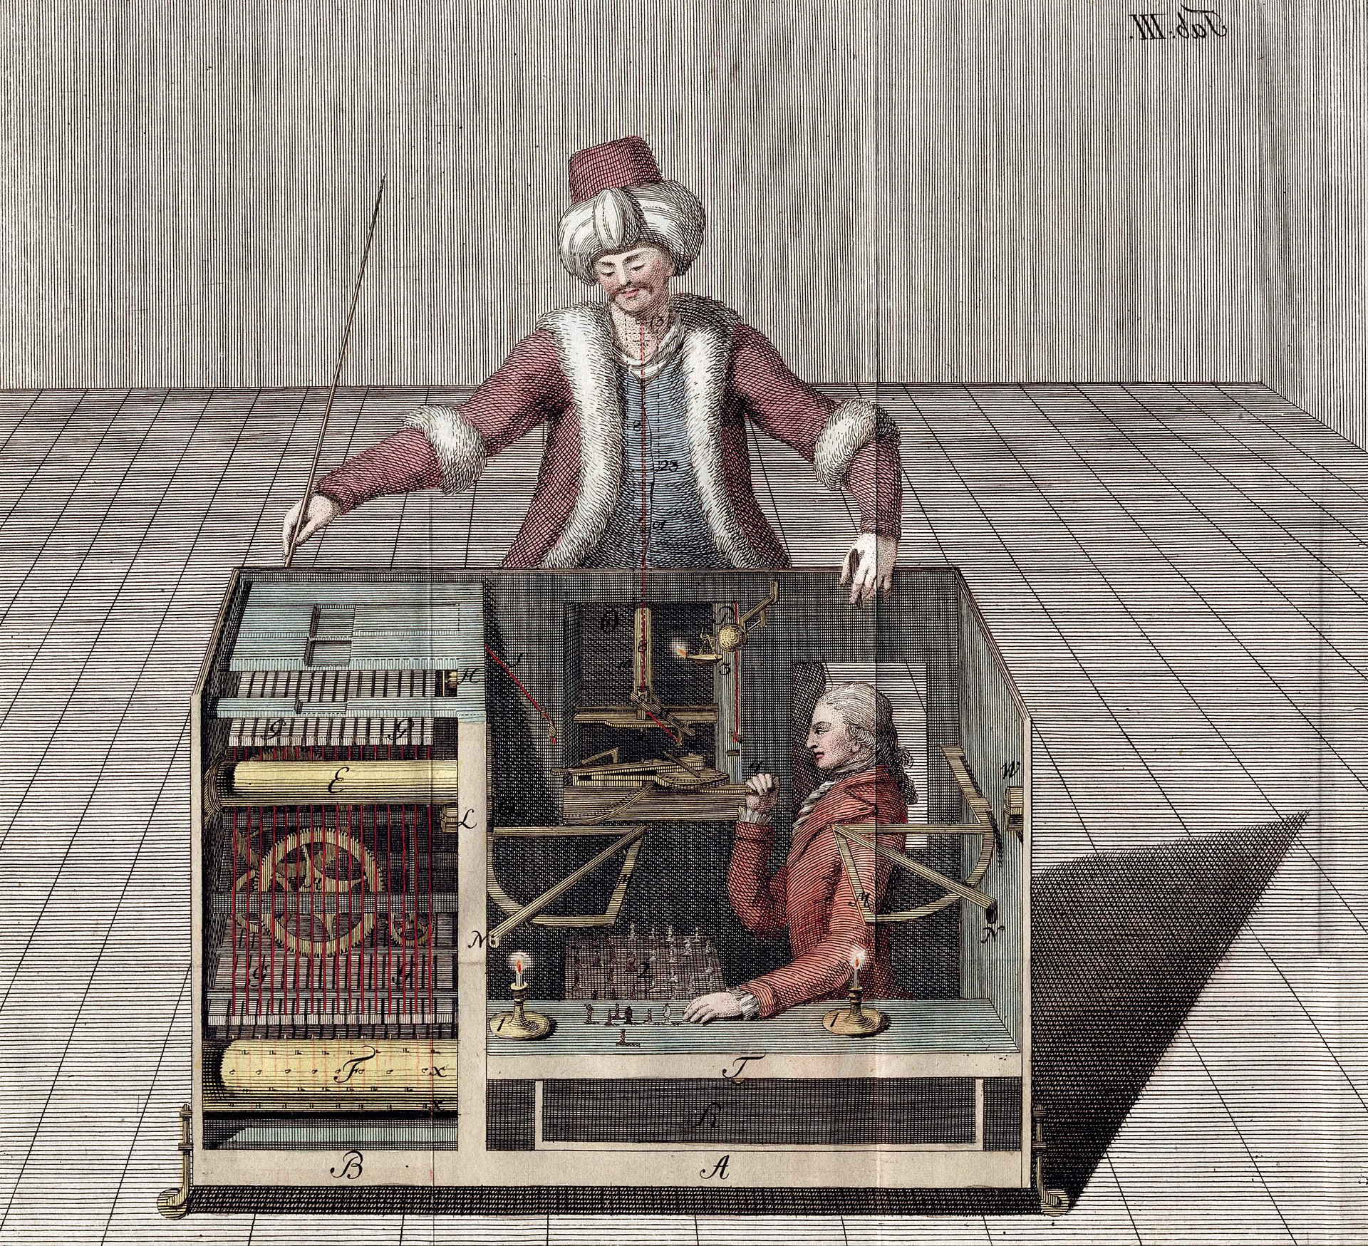

Slide 13
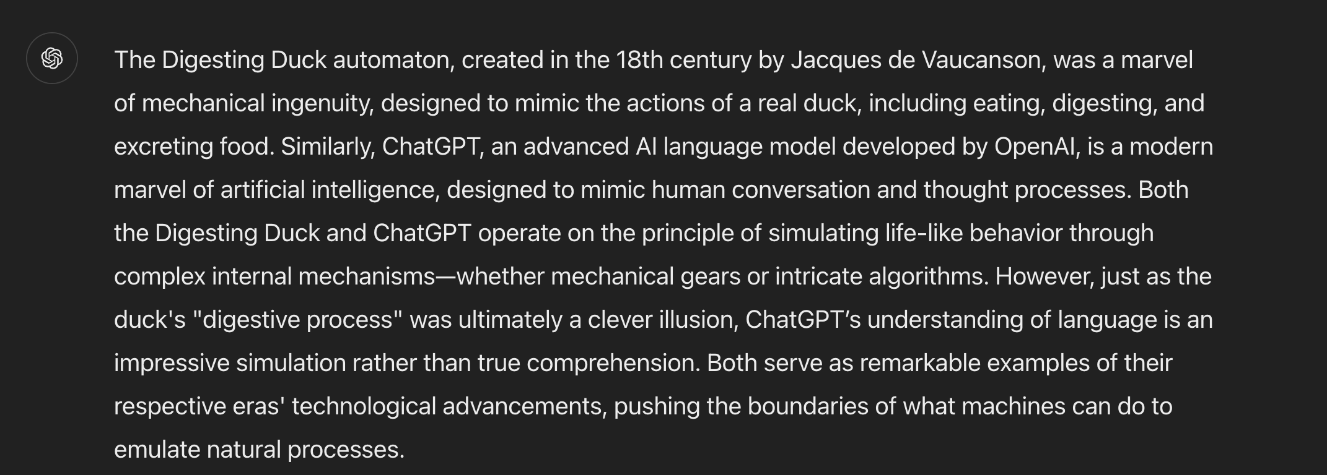
AI: An illusion?
Answer by ChatGPT

Slide 14
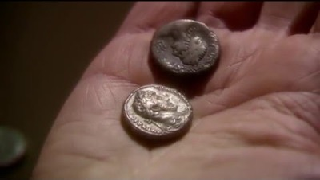
The first vending machine
Notes:
https://www.youtube.com/watch?v=4SMdjh5QR1g

Slide 15
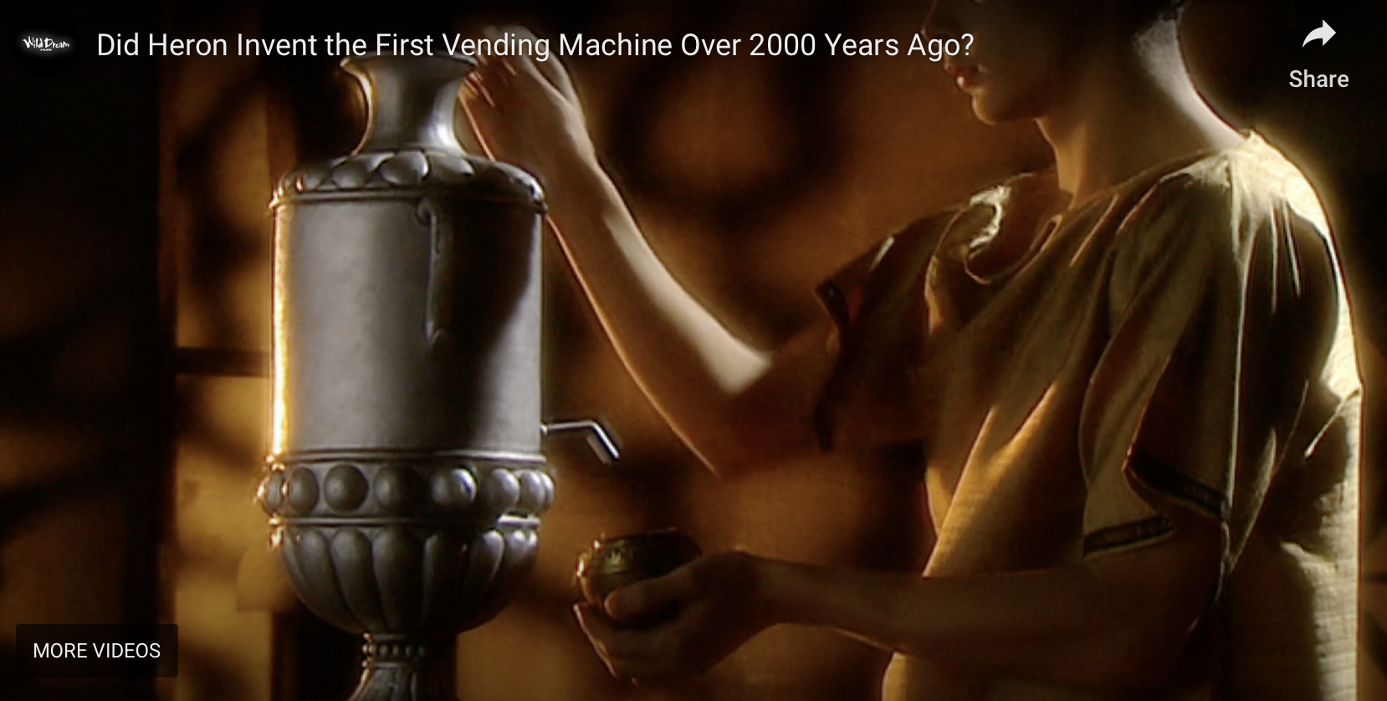
The first vending machine
Notes:
https://www.youtube.com/watch?v=4SMdjh5QR1g

Slide 16
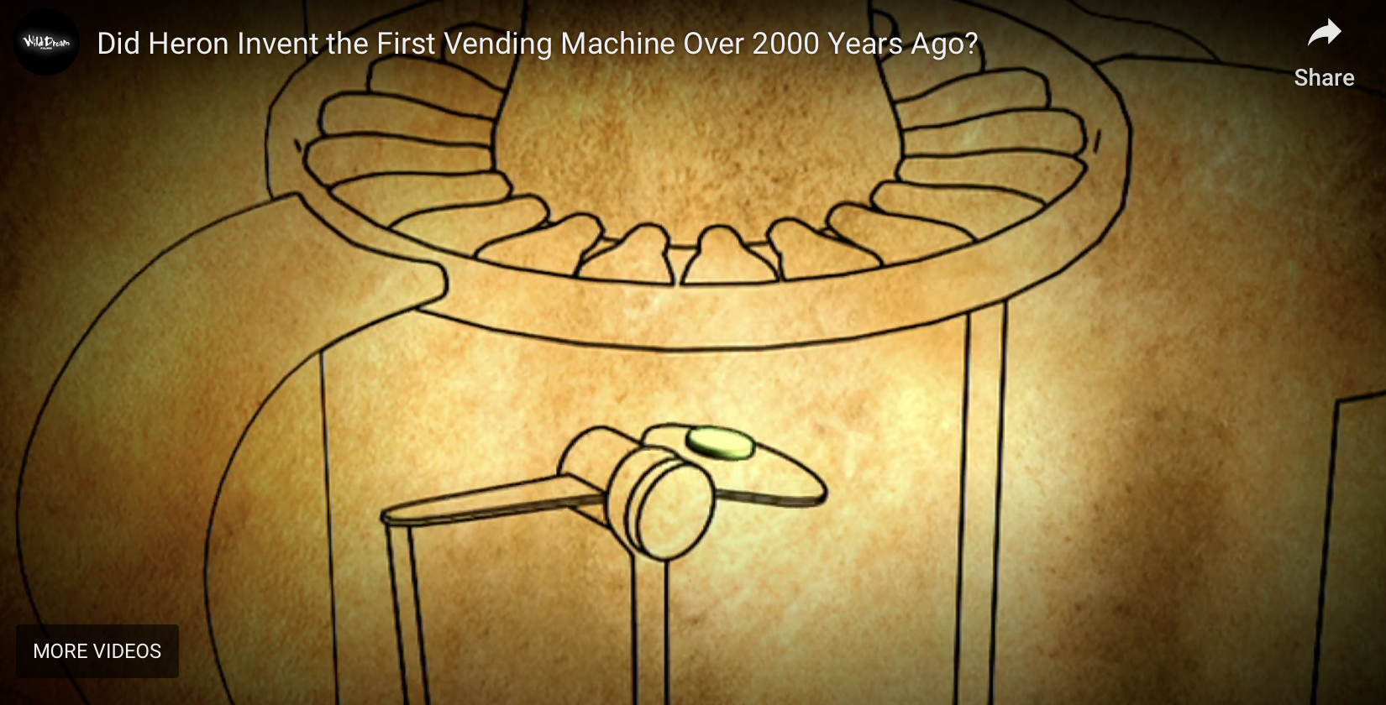
The first vending machine
Notes:
https://www.youtube.com/watch?v=4SMdjh5QR1g

Slide 17
AI: Magic?
Magic is done by magicians
Magicians (AI scientists and big-tech) can get in a position of privilege and abuse
Understanding AI and opening the black-box is important
Common people also need to understand what is AI

Slide 18
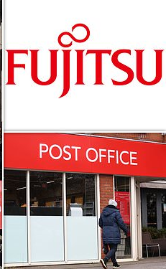
Should not substitute people with AI
Fujitsu scandal
Prosecutions and Convictions: Based on the evidence provided by the faulty Horizon IT system, the Post Office prosecuted around 736 postmasters for theft, fraud, and false accounting.
For years, postmasters insisted that they had not committed any crimes and that the discrepancies were due to issues with the Horizon system.
However, their concerns were dismissed by the Post Office, which relied on the Horizon system's data to assert their guilt.
Takeaway: Decisions should be made by people, not machines

Slide 19
Personal history
Worked in computational biology
Have a PhD in Computer Science
Worked in cell biology, clinical informatics, etc.
Also worked in supply chains (with industry)
Drug development (with industry)

Slide 20
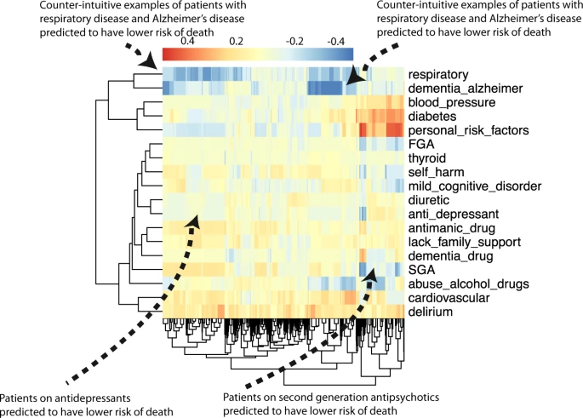


Interpretable machine learning
NPJ Schizophrenia, 2021 (Nature Partner Journal), Impact factor = 6.6

Slide 21
Background
The general public is disconnected from AI and there is mistrust
We do not trust what we do not understand

Slide 22
Risk of AI?
Critical stakeholders and end-users of AI or those who are impacted by AI are not involved in
Understanding AI models
AI model building
Patient and public involvement to build trust in artificial intelligence: a framework, tools and case studies, Soumya Banerjee, Phil Alsop, Linda Jones, Rudolf Cardinal, Patterns 3(6):100506, 2022

Slide 23
Human-AI Collaboration
The role of lived experience is very important
Frequently neglected in science
Patients just become data points

Slide 24

One fine day …

Slide 25
Patient comes up with research question!
Patient came up with hypothesis
Value of lived experience
Researchers (like me) frequently do not know what it feels like to have a disease

Slide 26
Tools for outreach
Tools for involvement and outreach
AI models that can be trained, run, and visualized in the Web browser, like the Teachable Machine
An AI model that runs in the Web browser and uses a webcam to detect facial expressions
A set of videos that demonstrate what AI can and cannot do
A resource of myths about AI
https://github.com/neelsoumya/ai_outreach
https://github.com/neelsoumya/ai_outreach

Slide 27
Why inform the public?
Public needs to be involved
Netherlands (benefits fraud detection system)
Fujitsu scandal in UK
Monitoring (and human rights violation) of Uyghurs in China
Citizen’s jury
Involving the public and end-users
May lead to trustworthy AI systems
Involving patients in artificial intelligence research to build trustworthy systems, Soumya Banerjee, Sarah Griffiths, AI & Society, 2023

Slide 28

We do not trust what we do not understand
Created with DreamUp AI

Slide 29
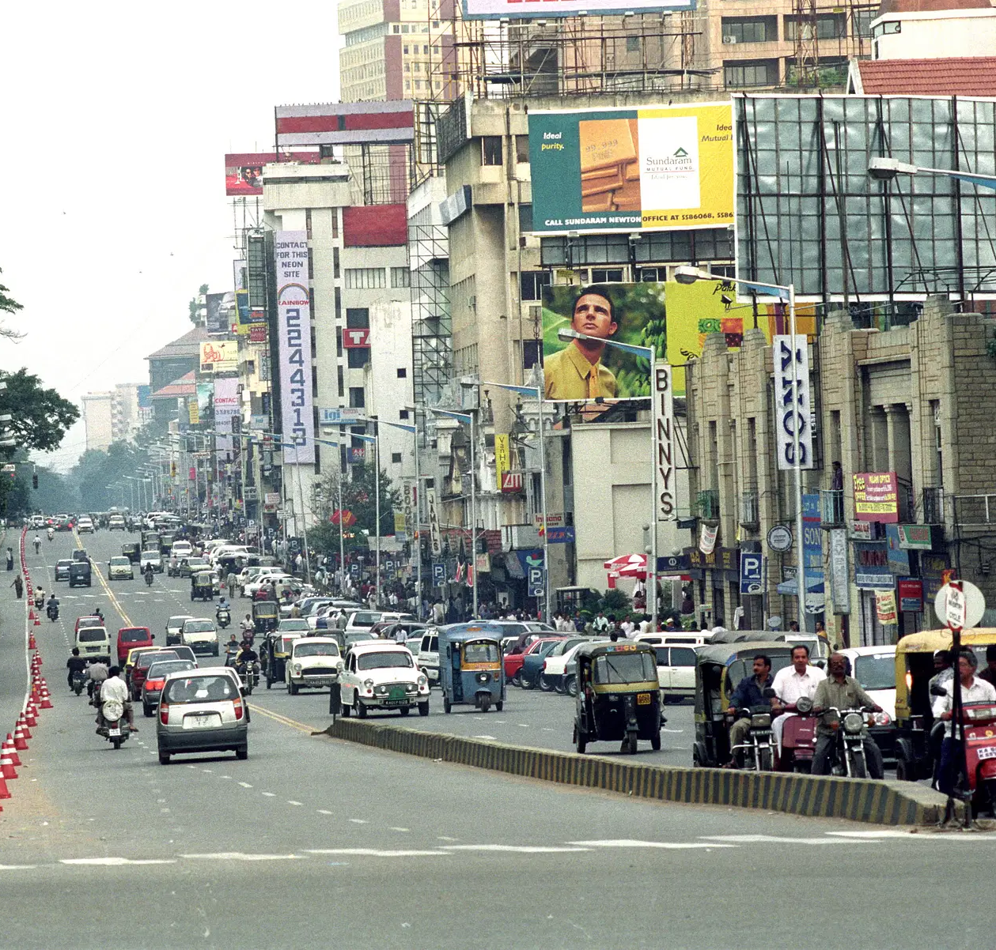
Impact of AI on India
1990s IT boom in India

Slide 30

Closing Message
Involve humans
Especially important for Global South where it can bring benefits
AI: Augmented Intelligence
Not Artificial Insanity

Slide 31
The Power of Curiosity
Let people/patients explore models on their own
https://github.com/neelsoumya/ai_outreach

